Slide 1
SELF-HEALING NETWORK INFRASTRUCTURE FOR PMU SYSTEMS
Energy Systems Division
Argonne National Laboratory

Slide 2

Architecture of an IP-Based PMU Network
Control Center
PMUs
PMUs
switch
WAN
PMUs
switch
switch
switch
switch
PDC
New path for effected PMUs
PDC
PMUs
PMUs
PMUs
PMUs
PMUs
Effected PMUs
Compromised PDC

Slide 3


Impact of Cyber-attacks to PMU Network
Control Center
PMUs/PDCs can be target of cyber-attacks
System observability highly reduced
Impact state estimation and other power system applications
PDC
PDC
PMU
PMU
PMUs
PMU
PMUs
PMUs
Under attack
Disconnected

Slide 4
Self-healing PMU Network for Power System Operation
Utilize features of programmable configuration enabled by software-defined networking (SDN) technology
After a cyber-attack, the compromised PMUs/PDCs will be isolated to prevent propagation of attack
Disconnected yet uncompromised PMUs will be reconnected to the network for self-healing
Restore observability of power system
Integer linear programming model – minimize overhead of self-healing process with constraints of power system observability, hardware resources, and network topology

Slide 5
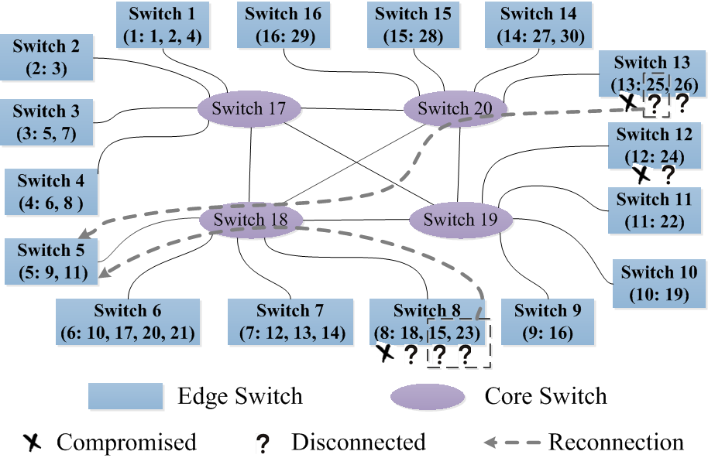
Demo: Self-healing Scheme on PMU Network for IEEE 30-bus System under an Attack Scenario
Communications network for the IEEE 30-bus system

